Slide 1
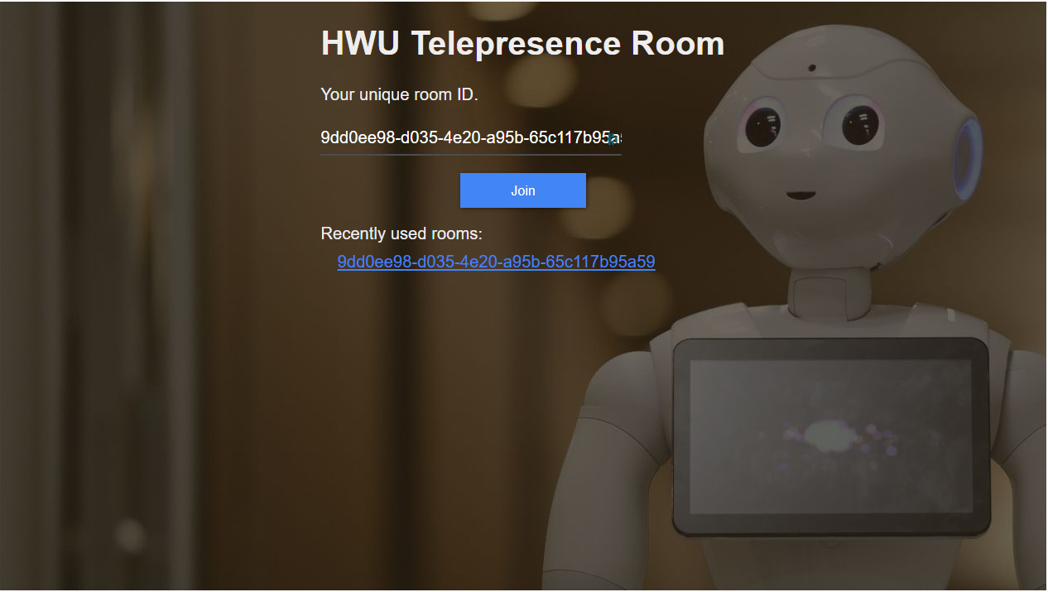

Slide 2
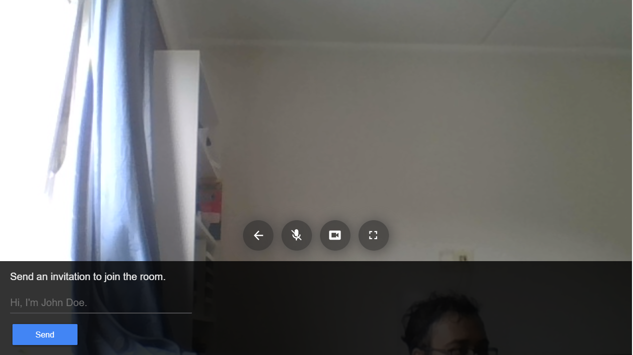

Slide 3
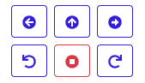
Move forward
Move sideway left
Move sideway right
Rotate left
Rotate right
Emergency stop

Slide 4
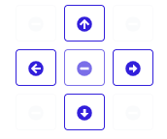
Look up
Look left
Look right
Look down

Slide 5

Move forward
Move sideway left
Move sideway right
Rotate left
Rotate right
Emergency stop

Slide 6

Look up
Look left
Look right
Look down

